Slide 1
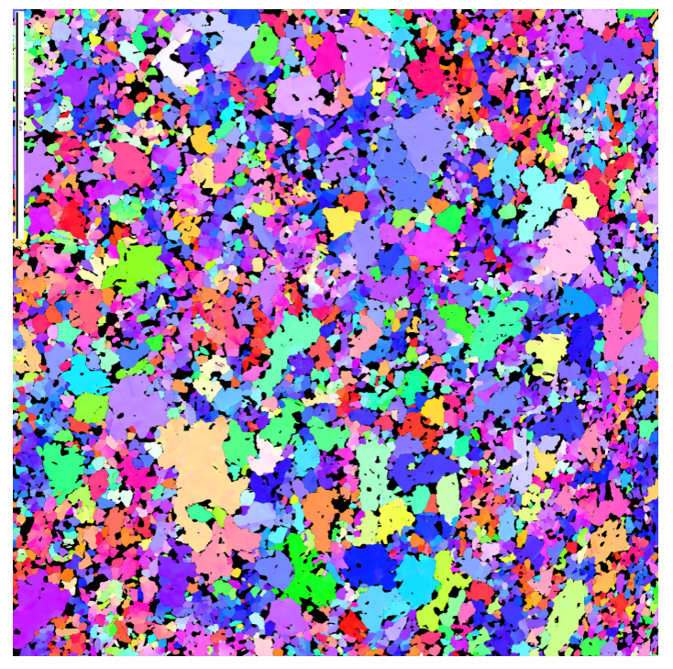
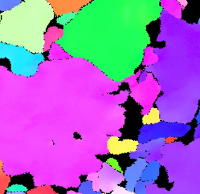

Grain 1-Purple
Position
1

Slide 2
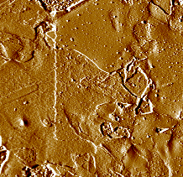
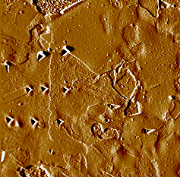
Grain 1-Purple
Position
1

Slide 3
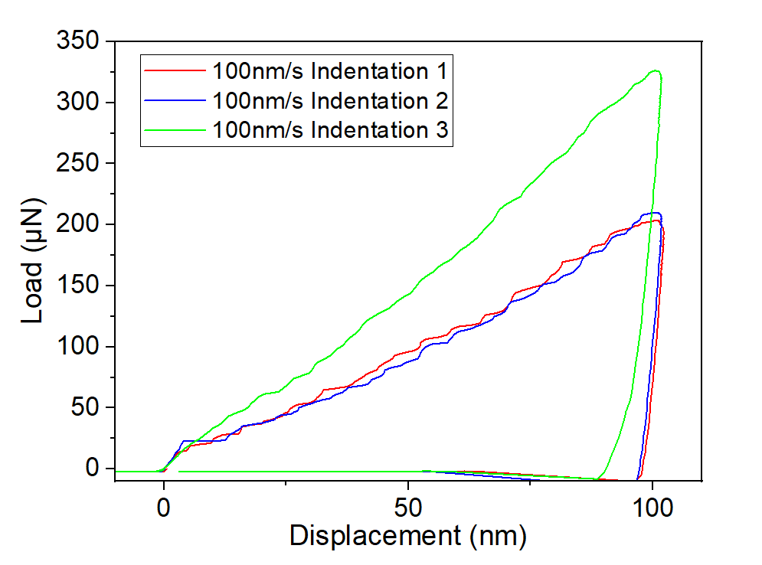
Grain 1
100nm/s
2

Slide 4
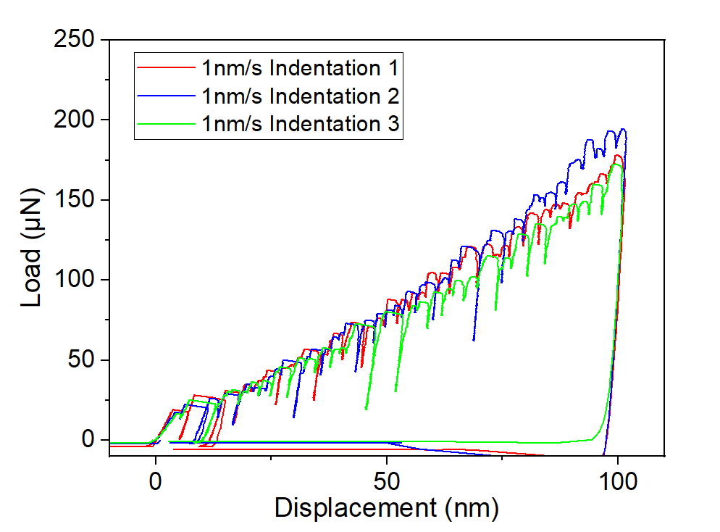
Grain 1
1nm/s
2

Slide 5
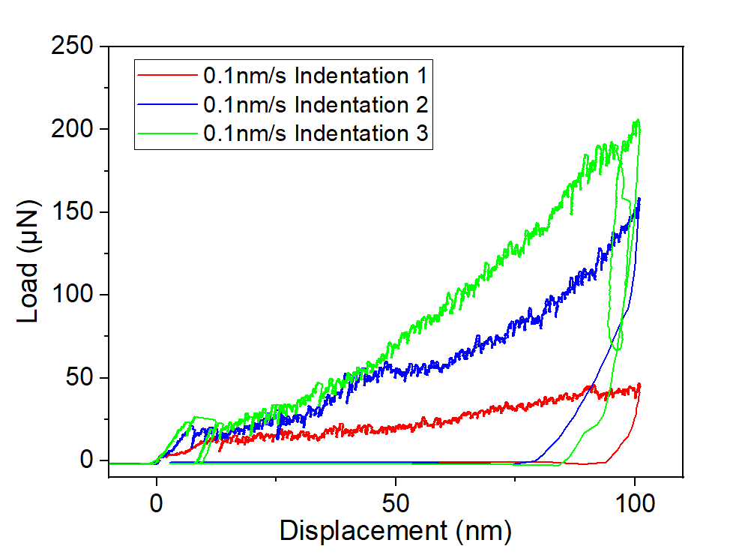
Grain 1
0.1nm/s
2

Slide 6
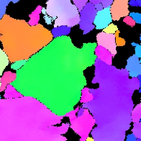
Grain 2-Green
Position
1

Slide 7
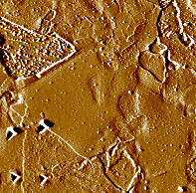
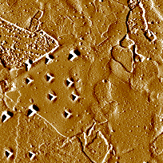
Grain 2-Green
Position
1

Slide 8
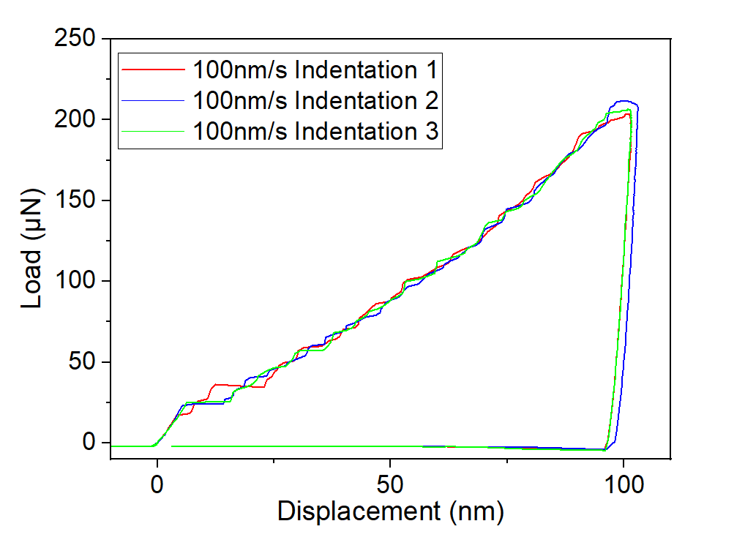
Grain 2
100nm/s
2

Slide 9
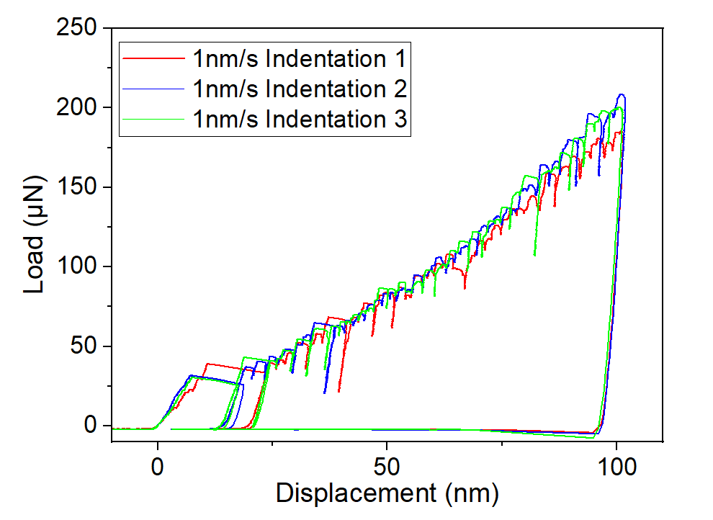
Grain 2
1nm/s
2

Slide 10
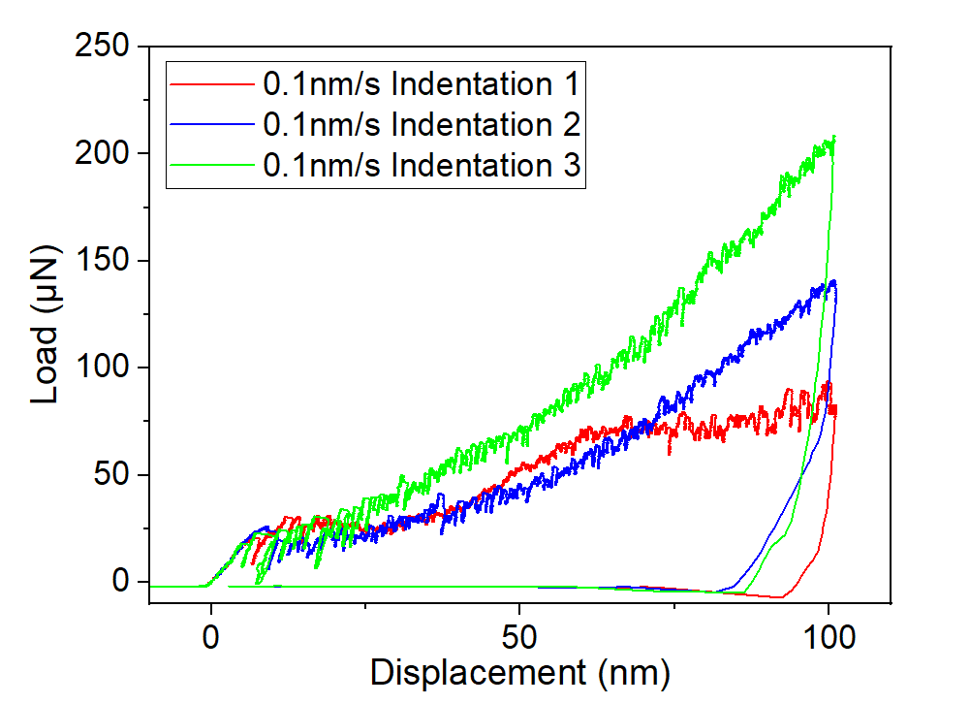
Grain 2
0.1nm/s
2

Slide 11
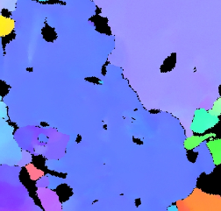
Grain 3-Blue
Position
1

Slide 12
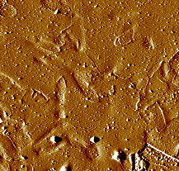
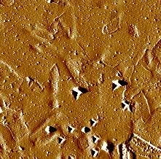
Grain 3-Blue
Position
1

Slide 13
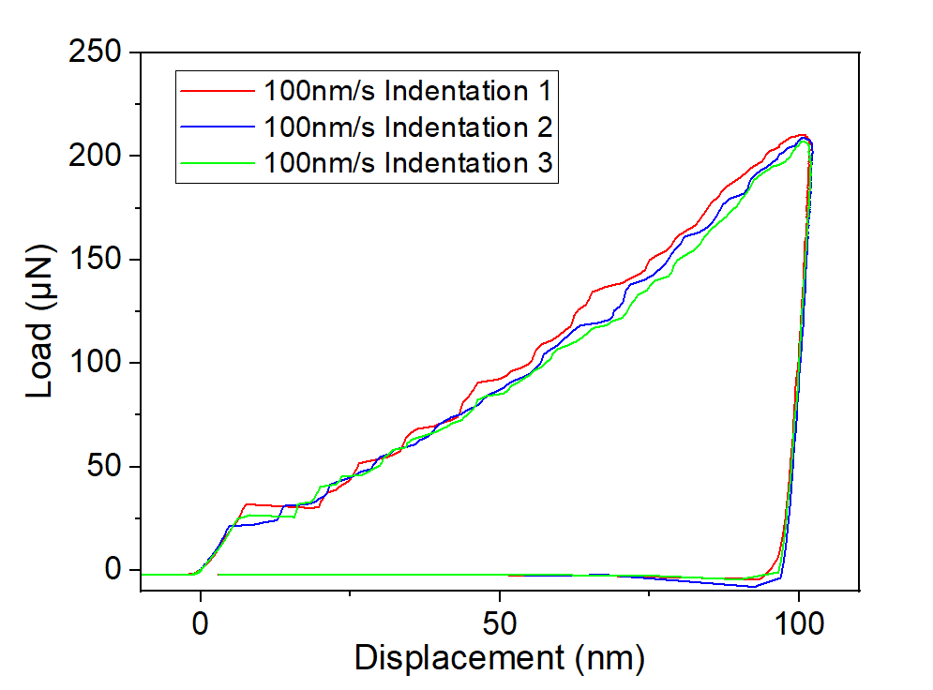
Grain 3
100nm/s
2

Slide 14
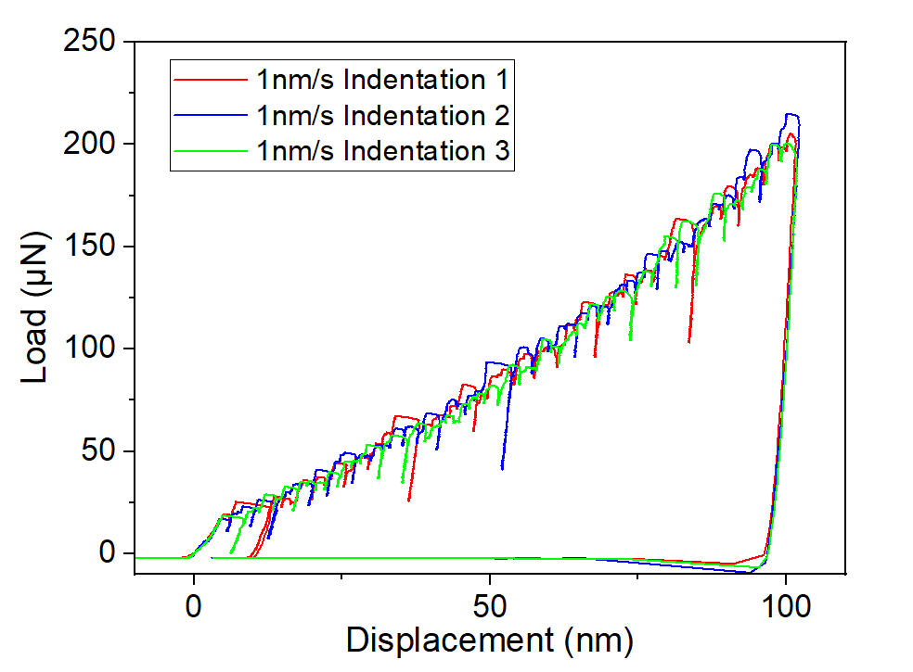
Grain 3
1nm/s
2

Slide 15
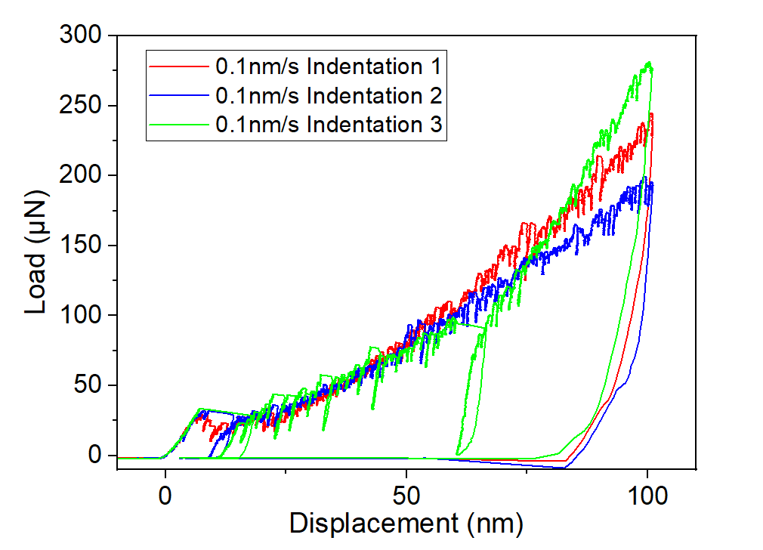
Grain 3
0.1nm/s
2

Slide 16
Hardness
Purple | 0.1nm/s | 1 | 0.574801
 |  | 2 | 2.184133
 |  | 3 | 2.629326
 | 1nm/s | 1 | 2.035075
 |  | 2 | 2.155851
 |  | 3 | 1.949478
 | 100nm/s | 1 | 2.033938
 |  | 2 | 2.290425
 |  | 3 | 3.855516
Blue | 0.1nm/s | 1 | 3.217875
 |  | 2 | 2.585584
 |  | 3 | 3.917117
 | 1nm/s | 1 | 2.429456
 |  | 2 | 2.207996
 |  | 3 | 2.132918
 | 100nm/s | 1 | 2.336491
 |  | 2 | 2.249818
 |  | 3 | 2.294191
Green | 0.1nm/s | 1 | 0.992926
 |  | 2 | 1.777265
 |  | 3 | 2.767319
 | 1nm/s | 1 | 2.228039
 |  | 2 | 2.249329
 |  | 3 | 2.440934
 | 100nm/s | 1 | 2.385522
 |  | 2 | 1.808311
 |  | 3 | 2.385265
2

